Slide 1
The National Institute of Standards and Technology (NIST) define Cloud Computing as “a model for enabling convenient, on-demand network access to a shared pool of configurable computing resources (e.g., networks, servers, storage, applications, services) that can be provisioned and released with minimal management effort or service provider interactions.”
Cloud Computing

Slide 2
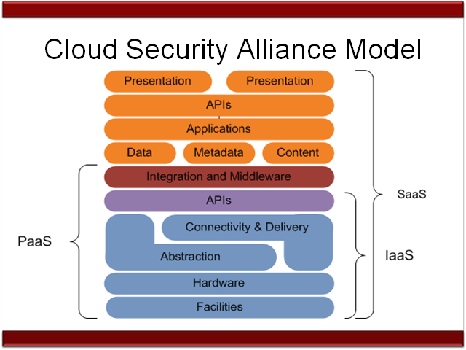
Source: CSA

Slide 3
SaaS - Software as a Service
SaaS
SaaS provides.
Applications are accessible from various capability to use the provider’s applications that run on a Cloud infrastructure client devices through a thin client interface such as a web browser (e.g. web-based e-mail).
SaaS allows a business application to be used by many individuals or enterprises concurrently.
SaaS is the ‘most used’ cloud applications to nearly everyone online.

Slide 4
Private Cloud
A “closed” environment for a single organization hosted by a third party.
Private clouds often employ virtualization within an enterprise’s existing computer servers to improve computer utilization.
A private cloud involves metering components, enabling rapid deployment and chargeback.

Slide 5
Public Cloud
A “shared” environment owned by an organization that sells Cloud services.
An offering from one Cloud Service Provider (CSP) to many clients who share the cloud processing power concurrently. Available to the general public or a large group.
Public cloud clients share applications, processing power and data storage space communally.

Slide 6
Community Cloud
Shared by several organizations
Supports a specific community with a common/shared mission or interest, such as a trade association, the same industry or a common locality.
The community cloud business model allows a CSP to provide cloud tools and applications specific to the needs of the community, managed by the organizations or a third party on or off premise.

Slide 7
Hybrid Cloud
A combination of two or more of the previously mentioned deployment models.
A hybrid cloud leverages the advantage of the other cloud models, providing a more optimal user experience.
A Cloud that is bound together by standardized or proprietary technology that enables data and application portability.

Slide 8
GAPP Framework (AICPA)
Management
Notice
Choice & Consent
Collection
Use and Retention
Access
Disclosure to Third Parties
Security for Privacy
Quality
Monitoring & Enforcement
66 Principles

Slide 9
Lilibeth Hanlon, CPA/CITP, CMA, CISA
www.BridgeStrategiesLLC.com
908.342.0510
Bridging CFO and CIO Services for
Governance, Risk and Compliance
Security & Privacy Programs
Notes:
Lilibeth Hanlon CPA CMA CISA
908-342-0510 cell
www.BridgeStrategiesllc.com

